Slide 1
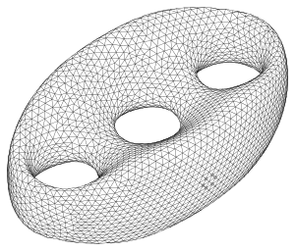
Random codes and holographic duality
Patrick Hayden
Stanford University
With Sepehr Nezami, Xiao-Liang Qi,
Nate Thomas, Michael Walter, Zhao Yang
A
arXiv:1601.01694
QIP 2016

Slide 2
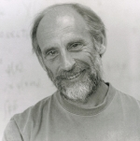

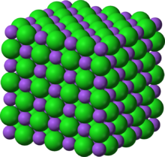
The Holographic Principle
The Holographic Principle:
All information in a region of space can be
represented as a “hologram” living on the
region’s bounding surface.
Susskind
‘t Hooft
Actually, not crazy. The most entropy-dense
possible object is a black hole, for which entropy
is proportional to area. (Bekenstein-Hawking)
That’s crazy! Entropy (log # states) is
proportional to volume!

Slide 3
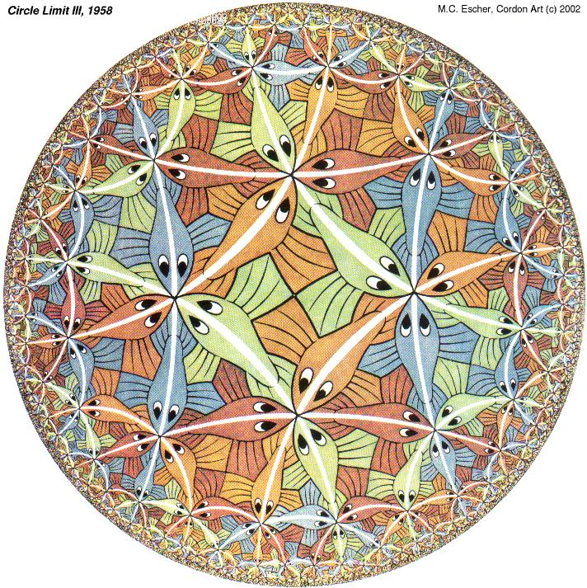
Anti-de Sitter/Conformal Field Theory Correspondence
Example:
Type IIB string theory on AdS₅ x S⁵
≅
Supersymmetric N=4 Yang-Mills
Bulk: D+1 dimensional
theory with gravity
(asymptotically AdS)
Boundary: D
dimensional CFT
Time
Conjecture: Equivalence of string (gravity) theory in bulk with CFT on boundary [Maldacena’97]
Question: How are bulk degrees of freedom encoded in the boundary?

Slide 4

Spatial slice of anti-de Sitter space
Hyperbolic space
Fish-counting metric
Geodesics (straight lines) follow fish
Negatively curved: sum of angles in triangle < 180º
Can place matter deep inside AdS

Slide 5
The plan
AdS/CFT starter kit
Geometry
Entropy
Random tensor networks
Reproducing the holographic entropy formula
Entanglement of assistance
Ambiguity in the AdS/CFT correspondence
Quantum error correction to the rescue!
Brief reports from the QI/QG frontier

Slide 6
Von Neumann entropy in AdS/CFT
CFT
Ryu-Takayanagi proposal for bulk formula:
γ_{A}
A
QM
GR
Minimize over spatial bulk surfaces γ_{A} homologous to A.
Generalizes black hole entropy
to wide class of spatial regions!
Analytical agreement in AdS₃/CFT₂ [RT’06]
Satisfies strong subaddivitiy [Headrick-T’07]
Proof for spherical A [Casini-Huerta-Myers’11]
General explanation [Lewkowycz-Maldacena’13]
A
BH

Slide 7
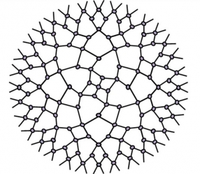
Space(time) as a tensor network
MERA: Multiscale Entanglement Renormalization Ansatz [Vidal 2007]
Efficient representation of CFT ground state as contraction of scale-invariant tensor network
Idea: Bulk space(time) is the tensor network [Swingle 2012]

Slide 8
Network of random tensors (PEPS)
G=(V,E)
Vertex tensors random:
Version 1: Unitarily invariant measure
Version 2: Random stabilizer states (d large prime)

Slide 9
Average Purity
Purity of entangled pair state on A union M
A
G=(V,E)
(c = # edges crossing cut)
Purity is dominated by MIN CUT for large d!
M
Ryu-Takayanagi holds for all boundary
regions in the limit of large d.
A

Slide 10
Entanglement of assistance picture
Possible interpretation: Start with a semiclassical bulk quantum gravity state
for which Planckian degrees of freedom satisfy area entanglement law.
Fix the bulk Planckian degrees of freedom to typical values. This induces
the Ryu-Takayanagi formula in the holographic dual boundary CFT.
G=(V,E)
A
B
Interpret random projections as measurements on an initial collection of Bell pairs
Multiparty entanglement “distillation” problem: induce entanglement between
A and B by measuring vertex systems and classically communicating results
[Smolin, Verstraete, Winter 2005][One-shot: Dutil-Hayden 2010]

Slide 11
Anti-de Sitter/Conformal Field Theory Correspondence
Example:
Type IIB string theory on AdS₅ x S⁵
≅
Supersymmetric N=4 Yang-Mills
Bulk: d+2 dimensional
theory with gravity
(asymptotically AdS)
Boundary: d+1
dimensional CFT
Time
Conjecture: Equivalence of string (gravity) theory in bulk with CFT on boundary [Maldacena’97]
Question: How are bulk degrees of freedom encoded in the boundary?

Slide 12

Relating bulk and boundary observables
Boundary in terms of bulk: extrapolate
r
AdS
CFT
CFT
AdS
Bulk in terms of boundary: smearing
K arises from solving some PDE’s (Green’s fn for classical bulk field equations)
Don’t always need the whole boundary to reconstruct a given ϕ(θ,r).
[Hamilton, Kabat, Lifschytz, Lowe 2006]

Slide 13
Puzzle
Blue encloses “causal wedge” of boundary red
In empty AdS, for boundary interval, blue is a geodesic
All bulk operators in a boundary region’s causal wedge
can be reconstructed using only that boundary region.
A^{c}
A^{c} not required to represent ϕ₂ on boundary
Fix φ₂ and rotate A around boundary.
A
Intersection of all these A^{c} is the empty set so
ϕ₂ acts trivially on the entire boundary: ϕ₂ ~ identity
CONTRADICTION!
[Almheiri, Dong, Harlow 2014]

Slide 14
Puzzle
A^{c}
A^{c} not required to reconstruct ϕ_{2.}
Fix φ₂ and rotate A around boundary.
A
Intersection of all these A^{c} is the empty set so
ϕ₂ acts trivially on the entire boundary: ϕ₂ ~ identity
CONTRADICTION!
[Almheiri, Dong, Harlow 2014]

Slide 15
Puzzle
A^{c}
A^{c} not required to reconstruct ϕ_{2.}
Fix φ₂ and rotate A around boundary.
A
Intersection of all these A^{c} is the empty set so
ϕ₂ acts trivially on the entire boundary: ϕ₂ ~ identity
CONTRADICTION!
Resolution: Conclusion that A^{c} wasn’t required is only true for a limited sets of states
in the boundary Hilbert space, those corresponding to local perturbations of a
fiducial state. (e.g. vacuum for empty AdS)
Boundary reconstruction of bulk operators is an example of quantum error correction!
Physical Hilbert space | CFT Hilbert space
Code subspace | Local perturbations of fiducial state
Logical operators | Bulk operators
[Almheiri, Dong, Harlow 2014]

Slide 16
The HaPPY paper (Precedes ours!)
Explicit codes: AdS/CFT we can all understand!
Boundary reconstruction for some bulk operators beyond the causal wedge
Random tensor tensor networks go even further, at the expense of explicit decoding

Slide 17
The entanglement wedge
A₁
MIDDLE
A₂
LEFT
RIGHT
Causal wedge: LEFT + RIGHT
Entanglement wedge: LEFT + MIDDLE + RIGHT
Hamilton, Kabat, Lifschytz, Lowe:
Can reconstruct all bulk operators in the causal wedge
Random tensor network model:
Can reconstruct all bulk operators in the full entanglement wedge
Why? Reduces to calculating mutual informations.

Slide 18
Random tensor models of holography
Ryu-Takayanagi formula for all boundary regions
Boundary reconstruction of all bulk operators in the entanglement wedge
Analog of Hawking-Page phase transition (appearance of a black hole)
Not restricted to AdS
Flat space is ok

Slide 19
What else recently at the QI/QG interface?
Infinite new families of entropy inequalities for holographic states
Query complexity implications of modifying
quantum mechanics to resolve the
black hole information problem
Bulk spacetime volumes (more generally action)
related to the circuit complexity of the boundary
quantum state representing them.

Slide 20
Gravitation from entanglement
Relative entropy:
Inequality
Equation at 1st order
1st Law of Entanglement Entropy
Change in “energy”
Combine with Ryu-Takayanagi and apply to all
boundary spheres in all positions and all frames
1st Law of Entanglement Entropy iff
Einstein’s Equation in bulk holds to linear order
Gravity is a consequence of quantum mechanics!
[Lashkari, McDermott, Van Raamsdonk 2014][Faulkner, Guica, Hartman, Myers, Van Raamsdonk 2014]

Slide 21
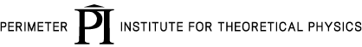

It from Qubit Summer School July 18-29, 2016
QI for Beginners
Daniel Gottesman
Patrick Hayden
John Preskill
Rob Spekkens
Guifre Vidal
John Watrous
Holography for Beginners
Horacio Casini
Veronika Hubeny
Tom Hartman
Dan Harlow
Mukund Ranagamani
Steve Shenker

